Slide 1
Introduction to SR and light sources
Manuel Sanchez del Rio
srio@esrf.eu
Advanced Analysis & Precision Unit, MEG/ISDD, ESRF

Slide 2
Outline
Generational intro
Light sources: BM, Wigglers and Undulators

Slide 3
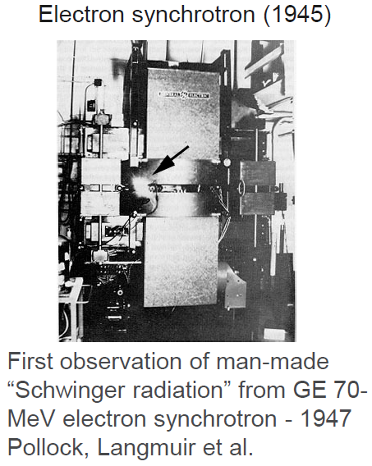
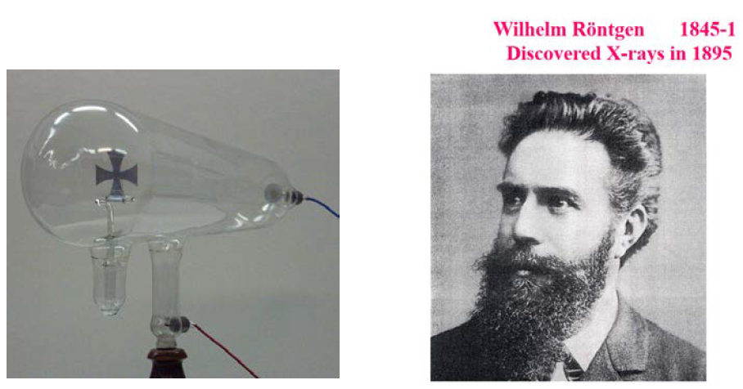
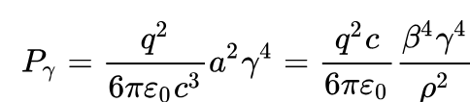
From X-rays to SR
https://doi.org/10.1119/1.13289

Slide 4
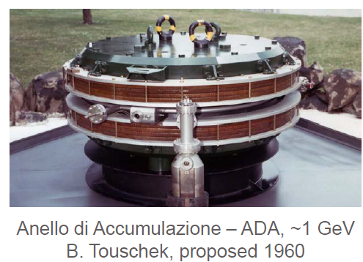
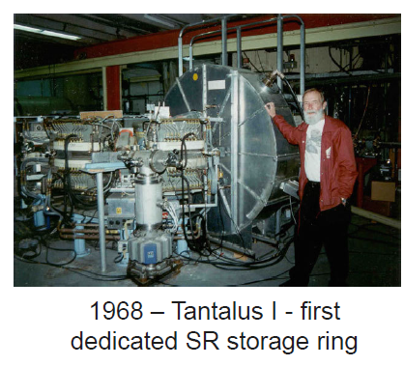
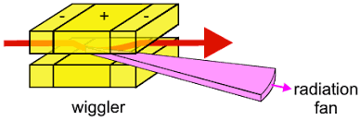
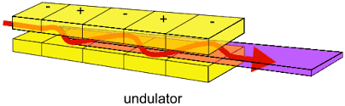
1st generation 1950-60 (parasite)
Moscow Univ/Lebedev Inst, DESY, Roma Univ/Frascati, Bonn Univ, NBS/Washington DC,
Univ of Tokyo, Cornell, CEA, NINA… SPEAR, DORIS, VEPP-3, DCI, CESR/CHESS, ...
end-1970-80 IDs
Winick et al (1981)
https://doi.org/10.1063/1.2914568

Slide 5
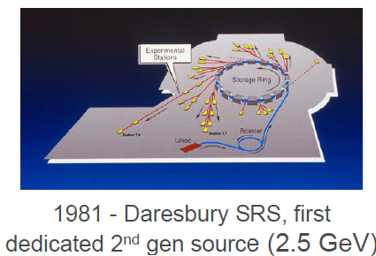
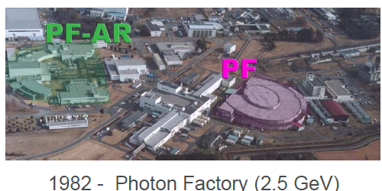
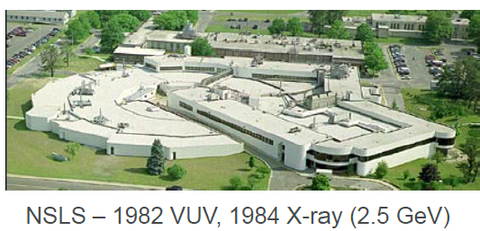
2nd generation (ε~100 10⁻⁹)
Parasitic or dedicated on storage rings using bend magnets and wigglers
Typically FODO lattices, few hundred nm-rad emittances
SOR-RING, SRS, Photon Factory, UV-SOR, NSLS-I, Aladdin, Super ACO, Hefei, …

Slide 6
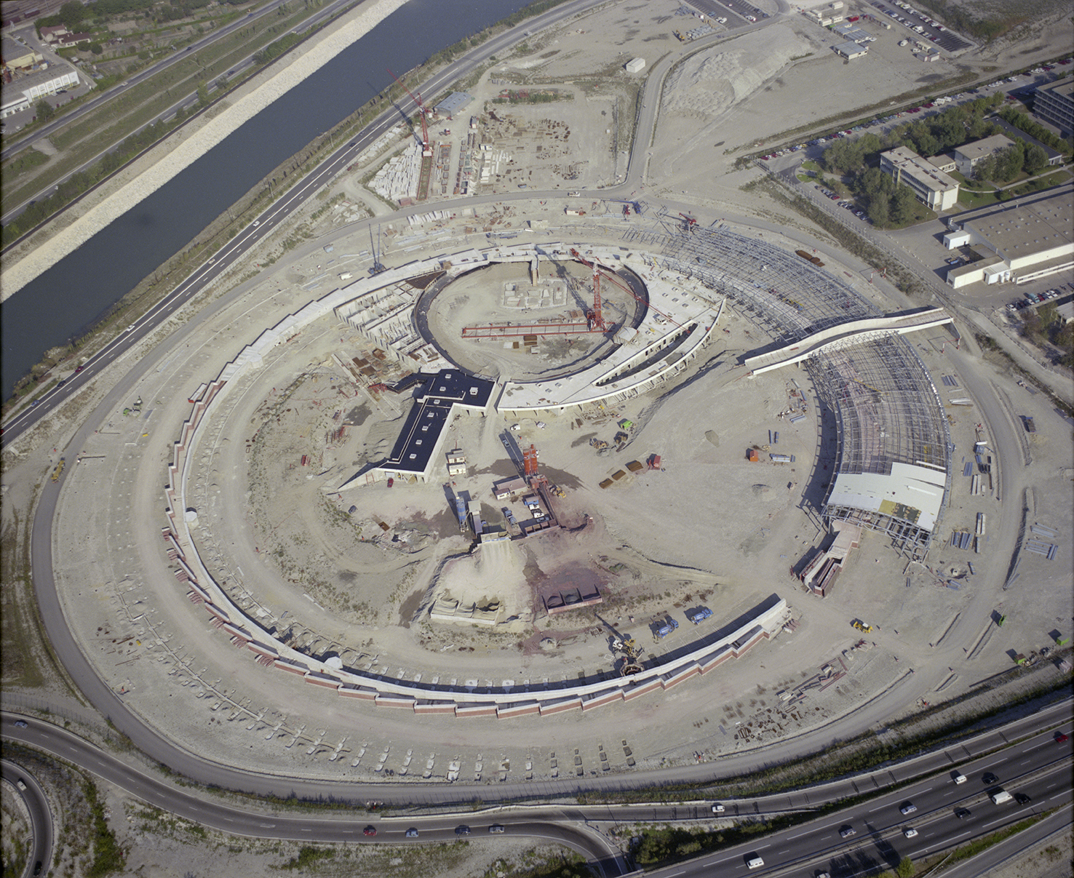
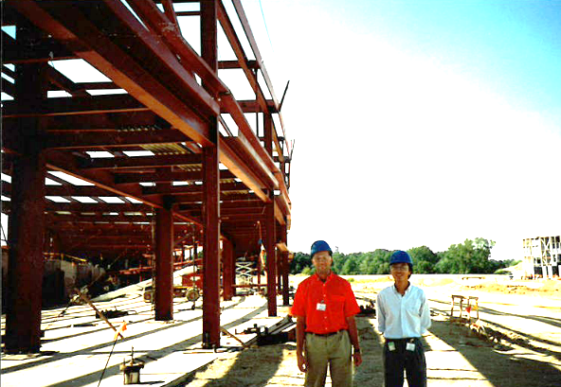
3rd generation (ε <10 10⁻⁹) – Dedicated and optimized for IDs
ESRF APS SPring-8 ALS ALBA BESSY-II SPEAR3 SLS DLS Soleil Elettra SSRF TPS PLS NSLS-II etc.

Slide 7
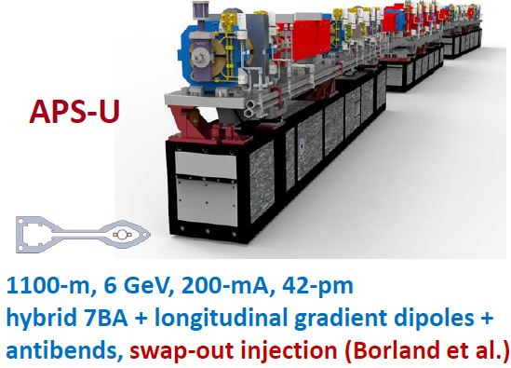
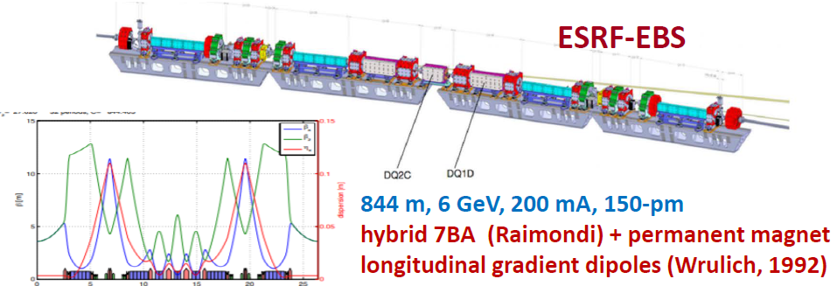
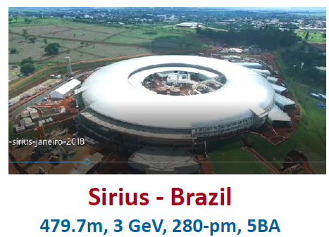
4th generation (ε ~ 100 10-¹²) – reduced H emittance to… DL?
MAX-IV, EBS-ESRF, …

Slide 8
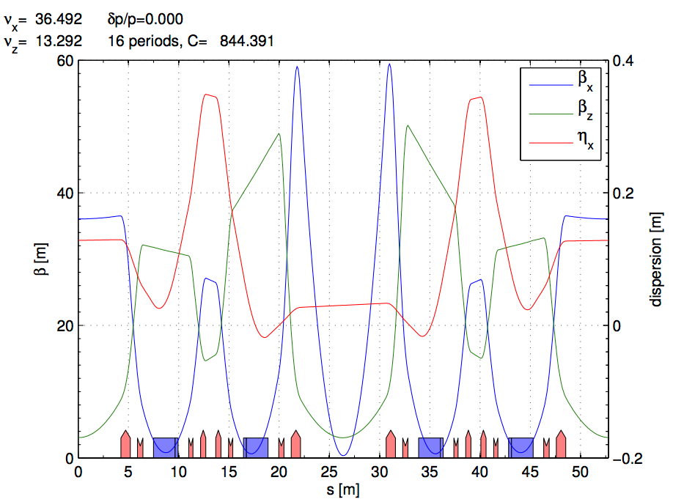
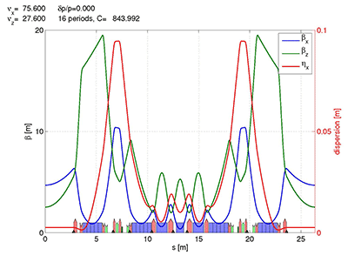
ESRF and EBS LATTICES
ESRF Double Bend Achromat (ESRF-1) -> Multi-bend achromat (EBS)
Horizontal emittance = 4000 pm Horizontal emittance = 137 pm
High Beta:
β_{x} = 37.59 m
β_{y} = 2.95 m
σ_{x} = 415.0 μm
σ_{y} = 3.43 μm
σ_{x’}= 10.3 μrad
σ_{z’}=1.16 μrad
Low Beta:
β_{x} = 0.35 m
β_{y} = 3.0 m
σ_{x} = 50.4 μm
σ_{y} = 3.44 μm
σ_{x’}= 107.2 μrad
σ_{z’}=1.16 μrad
EBS (S28D):
β_{x} = 6.90 m
β_{y} = 2.64 m
σ_{x} = 30.2 μm
σ_{y} = 3.64 μm
σ_{x’}= 4.37 μrad
σ_{z’}=1.37 μrad

Slide 9
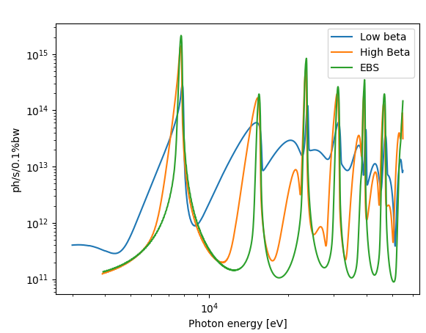
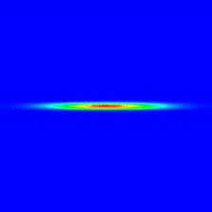
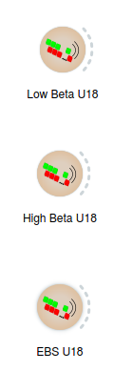
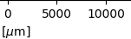
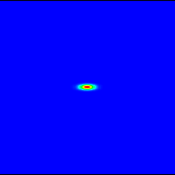
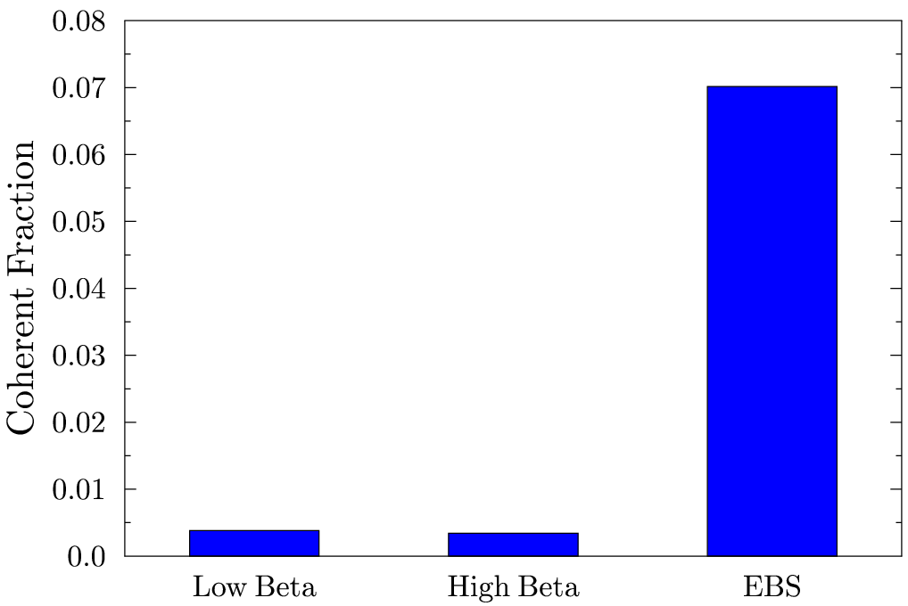
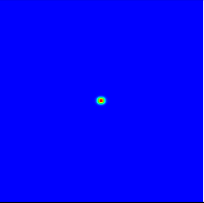
EBS – ESRF U18 2m @ 8 keV L=2m observed at 30m
Big increase of brightness and transverse coherence

Slide 10
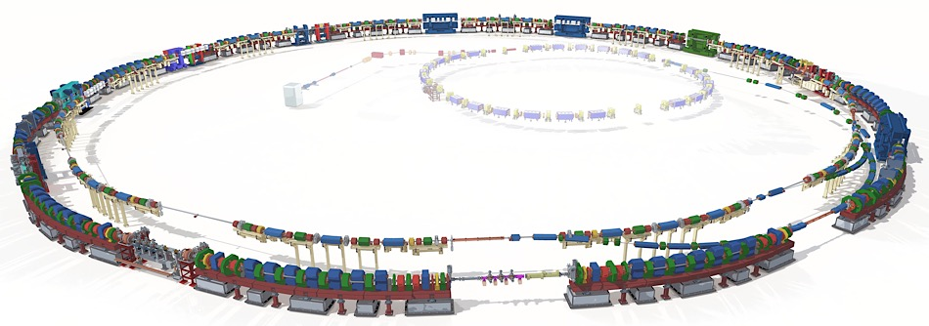
ALS-U
Electron Beam Profiles
Today’s ALS
Transfer lines
New full-length undulators optimized for high coherent flux
Linac
(existing)
Booster
(existing)
Future ALS
New 2.0 GeV accumulator ring for full-energy swap-out injection and recovery of bunch trains
New 2.0 GeV 9BA storage ring in existing tunnel optimized for low emittance and high soft x-ray brightness and coherent flux

Slide 11
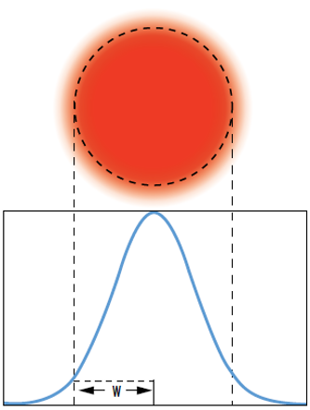
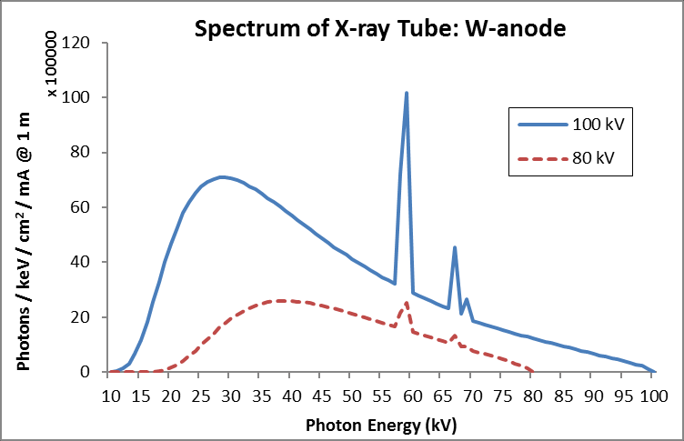
The Beam: Spectrum and Size
A light beam or beam of light is a directional projection of light energy radiating from a light source.
Collection of particles [photons]
Collection of waves
The main parameters can be represented:
As histograms if they are discrete variables
As functions if they are continuous variables
Spectrum I(E) Beam profile I(x,y) [cartesian]
y
x
I(E,x,y)
CORRELATED!
Size: FWHM
If profile is Gaussian
FWHM = 2.355 $σ$

Slide 12
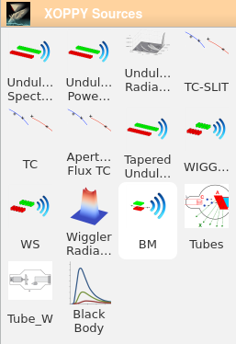
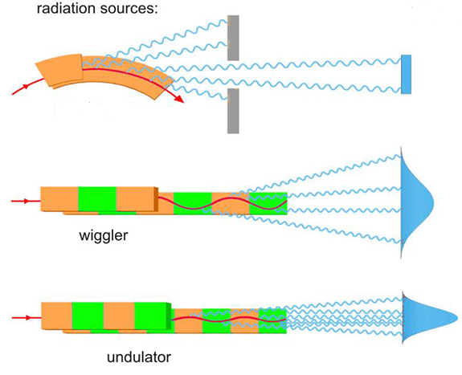
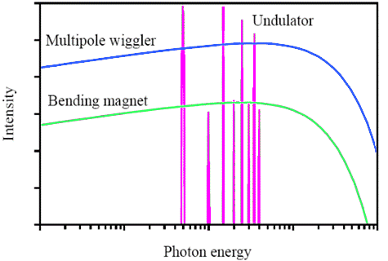
Simulation of source emission
Source spectrum (Photon flux or spectral power vs Energy)
XOPPY
Undulator
Wiggler
bending magnet
Bending
magnet

Slide 13
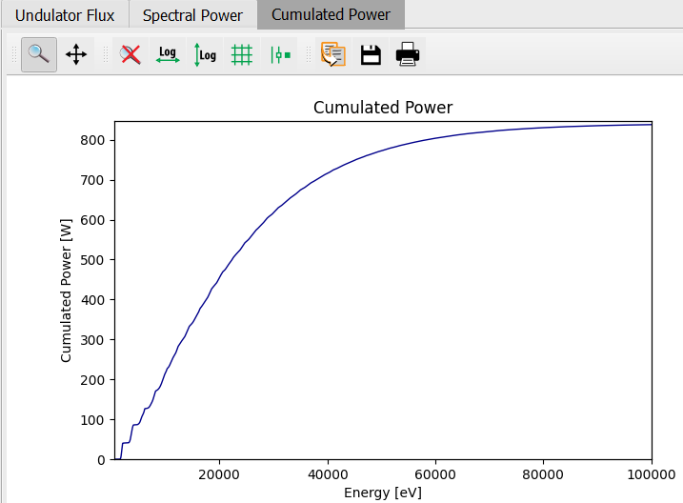
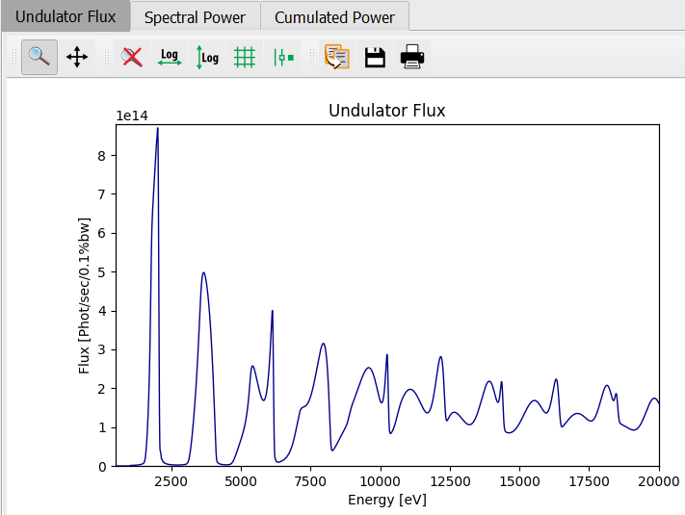
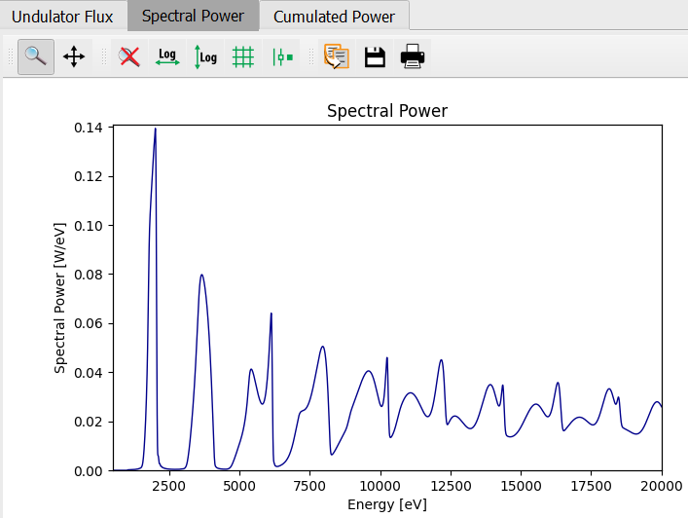
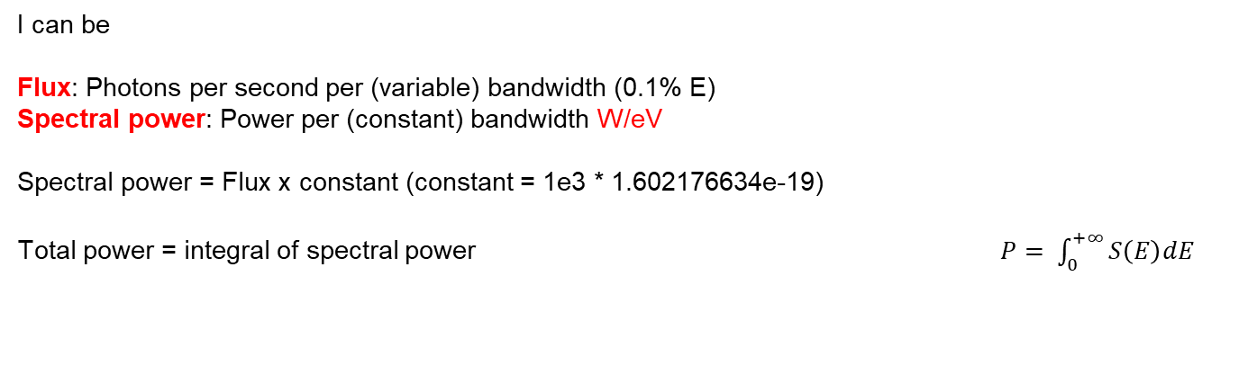
Intensity vs E
I can be
Flux: Photons per second per (variable) bandwidth (0.1% E)
Spectral power: Power per (constant) bandwidth W/eV
Spectral power = Flux x constant (constant = 1e3 * 1.602176634e-19)
Total power = integral of spectral power $P= \int_{0}^{+∞}{S\left(E\right)dE}$
cte = 1e3 * 1.6e-19

Slide 14
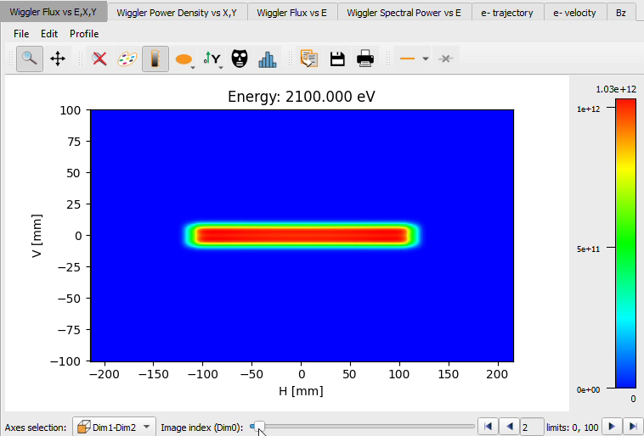
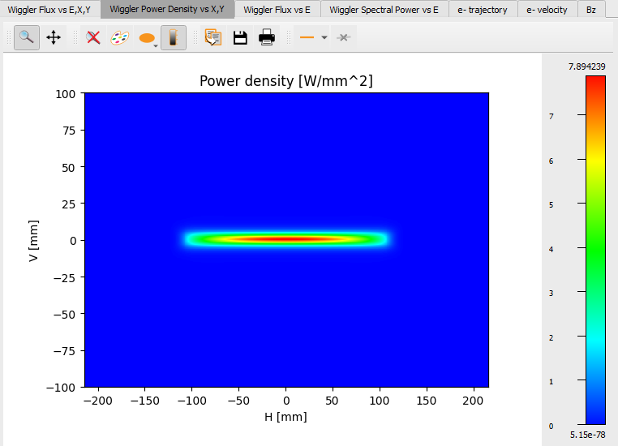
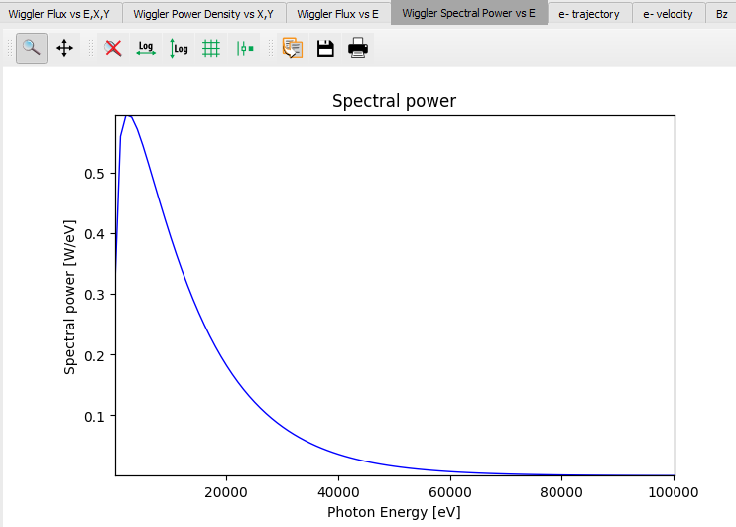
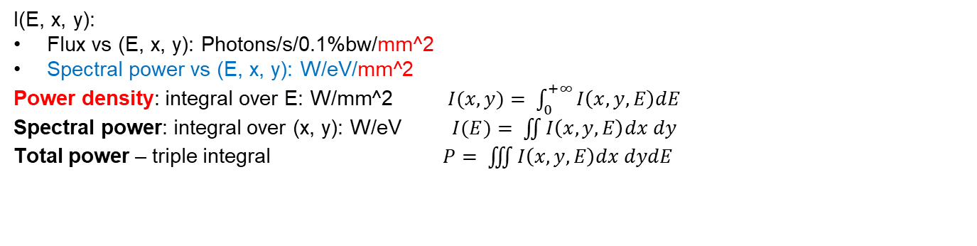
I(E) and I(x, y) are correlated (3D dependency)
I(E, x, y):
Flux vs (E, x, y): Photons/s/0.1%bw/mm^2
Spectral power vs (E, x, y): W/eV/mm^2
Power density: integral over E: W/mm^2 $I(x,y)= \int_{0}^{+∞}{I\left(x,y,E\right)dE}$
Spectral power: integral over (x, y): W/eV $I(E)= \iint{I\left(x,y,E\right)dx dy}$
Total power – triple integral $P= \iiint{I\left(x,y,E\right)dx dydE}$

Slide 15
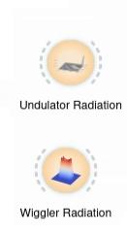
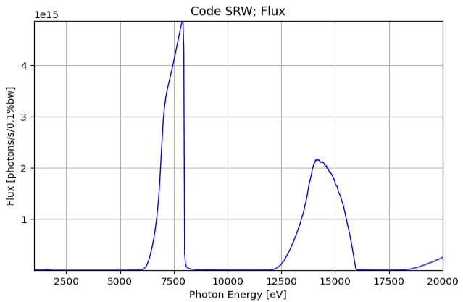
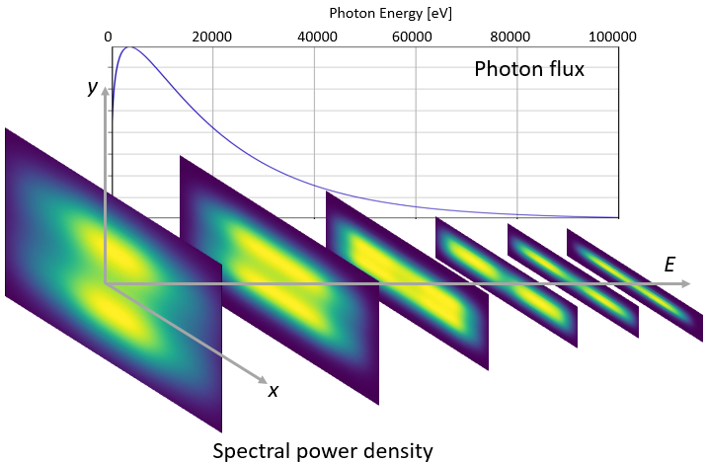
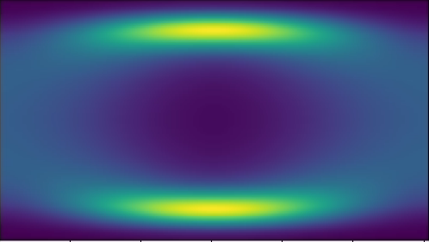
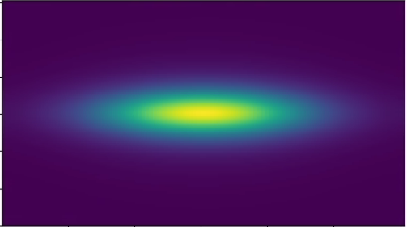
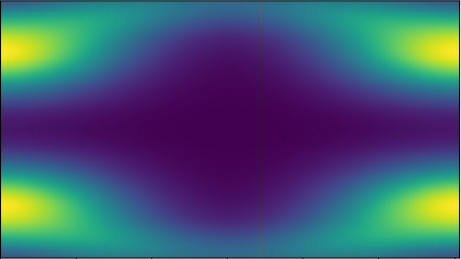
Examples of correlation between I(E) and I(x, y)
Undulator spectral flux density
(flux/power vs x, y, E)
Wiggler [and short ID’s] spectral flux density
(flux/power vs x, y, E)
Photon Energy [eV]
1000 5000 10000 15000 20000
y
Photon flux
E
x
Power density distribution of ESRF-3PW
https://jacow.org/medsi2020/papers/wepb17.pdf

Slide 16
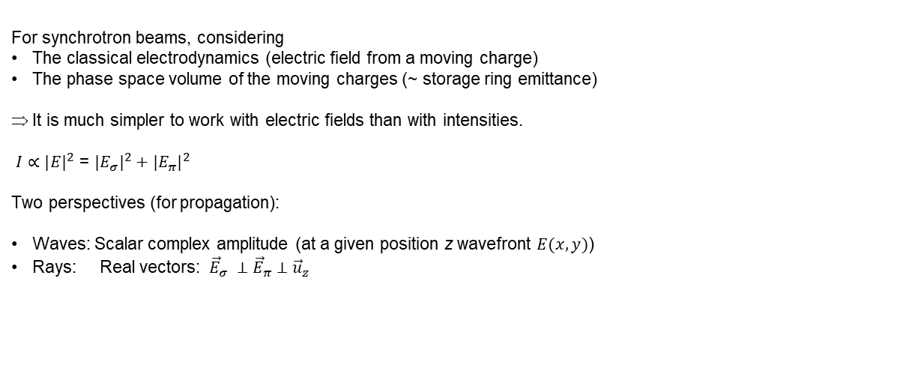
How “I” is calculated?
For synchrotron beams, considering
The classical electrodynamics (electric field from a moving charge)
The phase space volume of the moving charges (~ storage ring emittance)
It is much simpler to work with electric fields than with intensities.
$I∝{|E|}^{2}$ = ${|E_{σ}|}^{2}+{|E_{π}|}^{2}$
Two perspectives (for propagation):
Waves: Scalar complex amplitude (at a given position z wavefront $E(x,y)$)
Rays: Real vectors: ${\vec{E}}_{σ} ⊥{\vec{E}}_{π}$ $⊥{\vec{u}}_{z}$

Slide 17
Simulation of source emission
Undulator Spectrum (Flux/Spectral power)$I(E)$
Undulator power density (power vs x, y) $I(x,y)$
Undulator radiation (flux/power vs x, y, E) $I(E, x,y)$
Wiggler Spectrum $I(E)$
Wiggler radiation $I(E, x,y)$

Slide 18
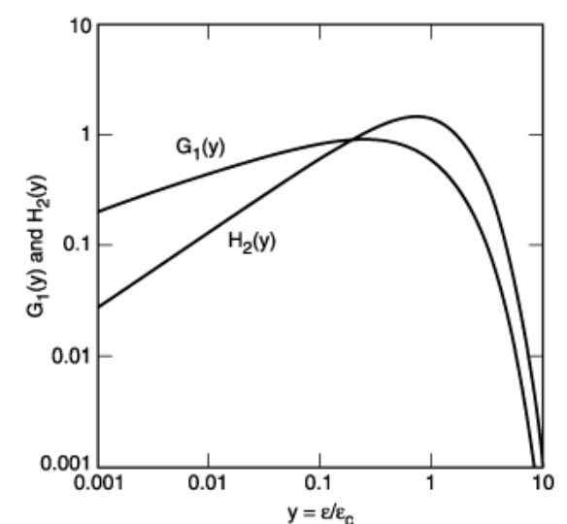
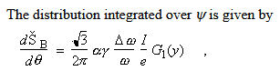
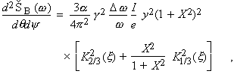
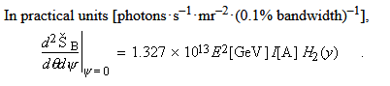
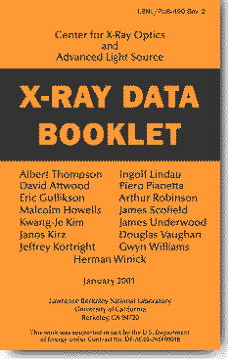


Bending magnets
https://xdb.lbl.gov/
See also: A A Sokolov and I M Ternov, Synchrotron Radiation, Akademik-Verlag, Berlin, 1968
https://srxraylib.readthedocs.io/en/latest/srfunc_examples.html

Slide 19





Insertion devices: K (deflection parameter)
$$K ≡\frac{eB_{0}λ_{u}}{2πmc}=0.9337B_{0}[T]λ_{u}[cm]$$

Slide 20















BM and wigglers: B(s), velocity e- trajectory

Slide 21




How Undulator Radiation is calculated?
Undulator

Slide 22





Undulator emission simulation
XOPPY
ESRF ID20 U32c
Undulator period
$$K ≡\frac{eB_{0}λ_{u}}{2πmc}=0.9337B_{0}[T]λ_{u}[cm]$$
$$λ_{n}=\frac{λ_{u}}{2γ^{2}n}\left(1+\frac{K^{2}}{2}+γ^{2}θ^{2}\right)$$
Photon wavelength
(harmonics)
Slit
“red shift”
$$θ$$
U42
30 m

Slide 23



Undulator emission simulation: Peak position vs aperture size
XOPPY
1st harmonic
$$λ_{n}=\frac{λ_{u}}{2γ^{2}n}\left(1+\frac{K^{2}}{2}+γ^{2}θ^{2}\right)$$
~50 eV
U42
Slit
$$θ$$
30 m

Slide 24


Undulator emission simulation: Peak position vs K
XOPPY
$$K↑ ⇒ λ_{n}↑ ⇒ E_{n}↓$$
$$λ_{n}=\frac{λ_{u}}{2γ^{2}n}\left(1+\frac{K^{2}}{2}+γ^{2}θ^{2}\right)$$
Memorandum:
$E\text{[}\text{eV}\text{]}= \frac{hc}{e}\frac{1}{ λ \text{[}\text{m}\text{]}}$= 1.2398e-06 $\frac{1}{ λ \text{[}\text{m}\text{]}}$
U42
$$K$$

Slide 25



Undulator emission simulation: Peak position vs K
XOPPY
$$λ_{n}=\frac{λ_{u}}{2γ^{2}n}\left(1+\frac{K^{2}}{2}+γ^{2}θ^{2}\right)$$
U42
$$K\sim B$$

Slide 26




Undulator emission simulation (gap)
$$e^{−}$$
Gap
$$K=0.9337B_{0}[T]λ_{u}[cm]$$
$$B_{0}=a∗e^{(−bπ∗\frac{gap}{λ_{u}})}$$

Slide 27

Undulator emission simulation
$$e^{−}$$
Gap
$$λ_{u}$$
Reducing
the gap
incrementing K
larger wavelength
$$B_{0}=a∗e^{(−bπ∗\frac{gap}{λ_{u}})}$$
$$K=0.9337B_{0}[T]λ_{u}[cm]$$
$$λ_{n}=\frac{λ_{u}}{2γ^{2}n}\left(1+\frac{K^{2}}{2}+γ^{2}θ^{2}\right)$$

Slide 28


Approximating emission on-resonance by Gaussians Onuki & Elleaume Undulators, Wigglers and their applications, CRC press, 2002
OASYS-Photon transport | HERCULES2024
Undulator radiation approximated by Gaussians (at resonances) are not Fourier pairs (like beams following the Gaussian Shell-model)

Slide 29











Electron energy dispersion effect in Undulator (on-resonance)
Single e⁻
Many e⁻
Photon source:
Divergence:
Size:
Emittance:
Tanaka & Kitamura:
Tanaka, T. & Kitamura, H. (2009).
J. Synchrotron Rad. 16, 380–386.
https://doi.org/10.1107/S0909049509009479
Sanchez del Rio, M. & Reyes-Herrera, J. (2025).
J. Synchrotron Rad. 32, 340–354.
http://dx.doi.org/10.1107/S1600577525000190
X=

Slide 30


Electron energy dispersion effect in Undulator (off-resonance)
Sanchez del Rio, M. & Reyes-Herrera, J. (2025).
J. Synchrotron Rad. 32, 340–354.
http://dx.doi.org/10.1107/S1600577525000190
angle
angle
angle
size
angle
size
Nash, B., Chubar, O., Bruhwiler, D. L., Rakitin, M., Moeller, P., Nagler, R. & Goldring, N. (2019). Proc. SPIE, 11110, 111100K
https://doi.org/10.1117/12.2530663
Note that the most changes (values that separate from one) are observed for small values of E − E0.
We compared these results with the values from Nash et al. (2019) applied to our particular undulator. The map for angles (c) agrees well with our corresponding r.m.s. map (a)

Slide 31
Summary
SR from SR (Synchrotron radiation from storage rings) is nowadays the most useful way to exploit high brilliance X-rays
Among the IDs (BM, Wigglers and Undulators) the undulators are the most efficient sources of X-rays. But the emission is complicated!

